Slide 1
Vulnerability Scanner in OAuth 2.0 related Vulnerabilities
Master Thesis
Karabalis Evangelos (320013)
Supervisor Professor:
Kambourakis George
University of Aegean
INFORMATION AND COMMUNICATION SYSTEM SECURITY

Slide 2
01
02
INTRODUCTION
OBJECTIVE
03
04
METHODOLOGY
IMPLEMENTATION
RESULTS & FUTURE WORK
05

Slide 3
01
INTRODUCTION

Slide 4
The trouble with authorization
Let’s imagine an application (draw.io) which edits diagrams and someone (User) wants to give permissions to the app to edit some diagrams that are placed in another application where the user has an account. (website B - e.g Google Drive).
What’s the solution???
Notes:
Draw.io needs to have Google credentials in order to access diagrams
So draw.io stores such credentials
Example
User : Bob
Client : draw.io
Authorization Server : google.com
Resource Server : google drive

Slide 5
Before OAuth
The only way to do this, was to give the user’s credentials for the other party (e.g Google credentials) to the draw.io in order to edit the diagrams directly.
Services recognized the problems with password authentication
Many services tried to implement custom solutions that had many vulnerabilities
Each implementation was slightly different, and not compatible with each other
Notes:
Apps stored the user’s password
Apps got complete access to the user’s account
Users couldn’t revoke access to an app except by changing their password
Compromised apps exposed the user’s passwords

Slide 6
The Solution
Introduction to OAuth 2.0
OAuth is a delegation prototype that is described in (RFC 6749) and it is designed to provide authorization across systems.
Key points : How to get a token and how to use a token
Replaces the password-sharing anti-pattern with a delegation protocol, which is more secure and more practical.
Notes:
Related Specs: https://oauth.net/specs/

Slide 7
OAuth 2.0 related definitions
Resource Owner: The User (Bob)
Resource Server: The API (Google Drive)
Authorization Server: Often the same as the API Server (Google.com)
Client: The Third-Party Application that requests authorization (Draw.io)
User Agent: Device or even the Browser (Browser)
Use Cases - Grant Types
Web-server apps - authorization_code
Browser-based apps/ mobile apps - implicit
Username/password access - password/device
Services access - client_credentials

Slide 8
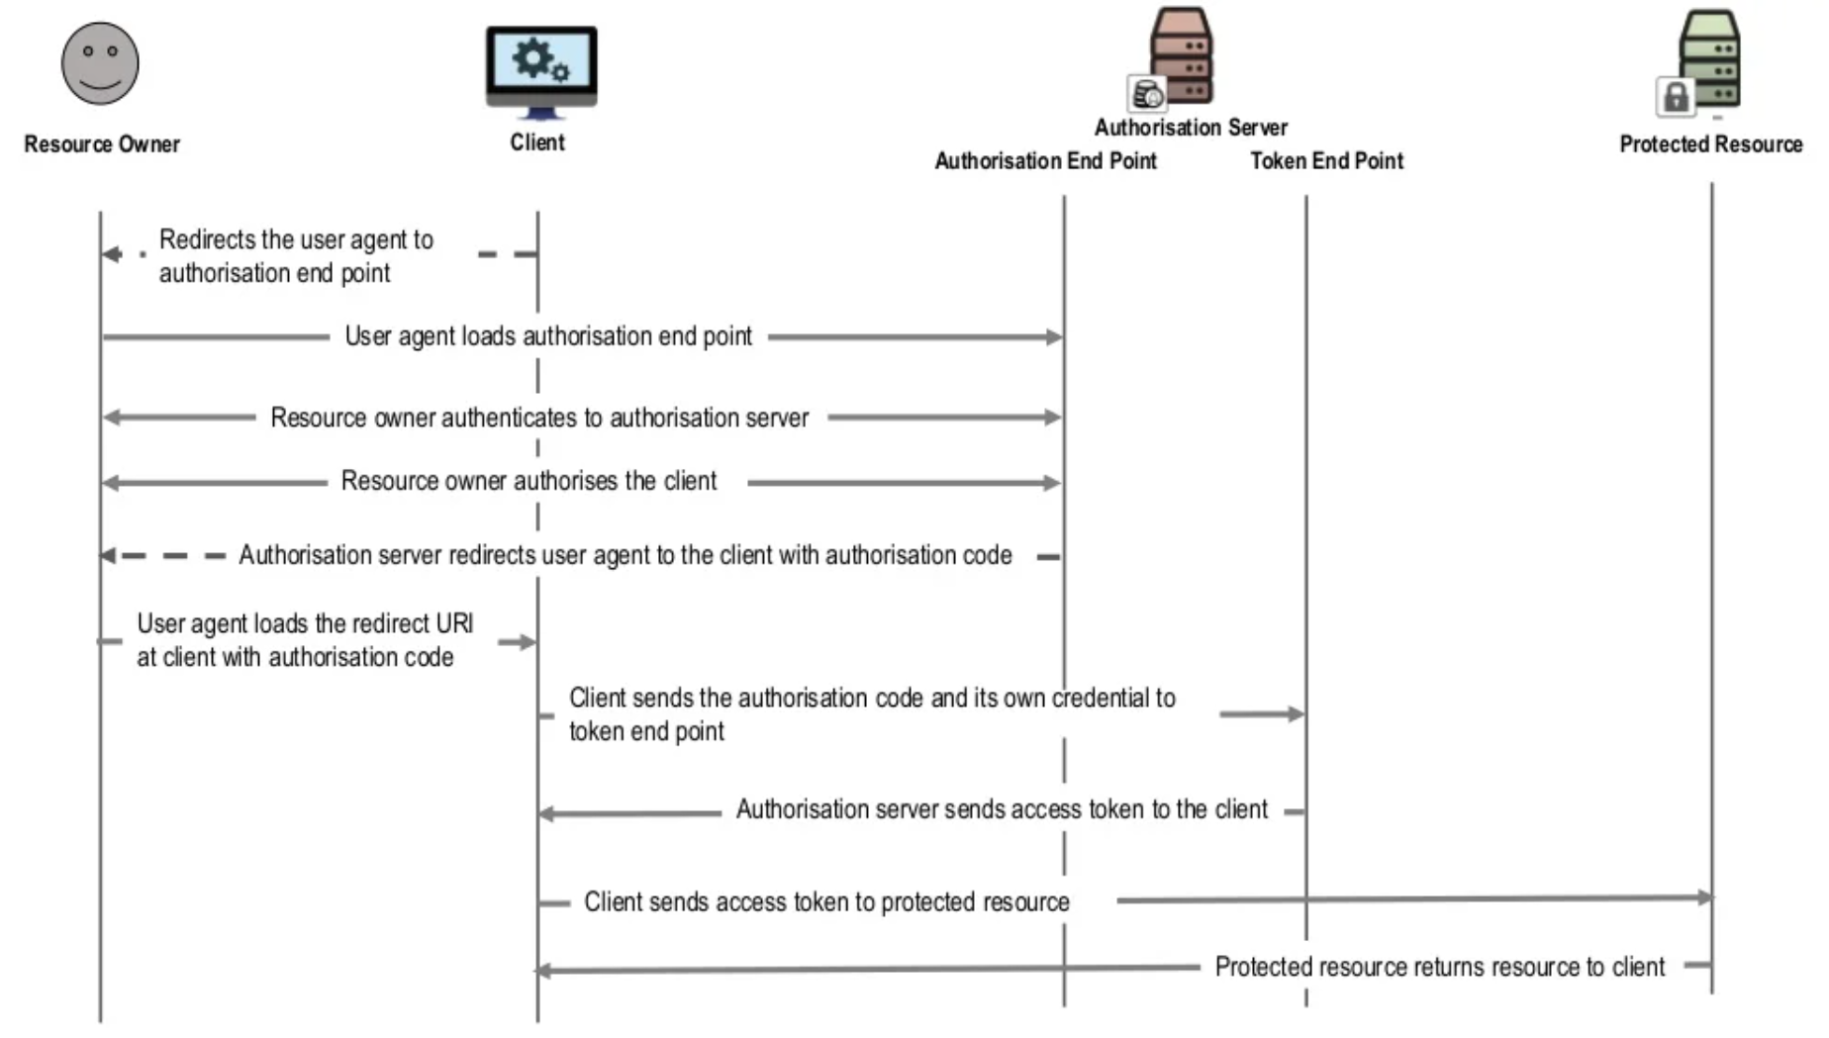
Simplified OAuth 2.0 auth_code flow

Slide 9
02
OBJECTIVES

Slide 10
The main objective
To explore all of the potential OAuth related risks that could be raised
  For this purpose studied on the relevant OAuth RFCs & drafts:
    Threat modeling and security considerations (RFC 6819 )
    OAuth 2.0 Best Current Security Practice
To implement a framework that could detect such kinds of vulnerabilities particularly in one of the most common flows of OAuth (Authorization Code Flow).
  For this purpose the framework “OAuthVulnerability Scanner” was implemented which tries to detect the most common security misconfigurations or misconceptions that could potentially lead to a security risk.
Notes:
Videos:
Okta replay
Okta all
Keycloack
Project Git Repo
https://github.com/vagelkara/OAuthVulnerabilityScanner
Who is this tool for?

Slide 11
FAMILIARIZING WITH USEFUL TERMS RELATED TO SELECTED ATTACKS (1)
Nonce
Based on OpenID specs nonce parameter is used to associate a client session with an Id_token and to mitigate replay attacks. If there are no measures to prevent replay, an attacker could be able to retrieve a valid auth request and potentially access/modifies the user’s resources.
Authorization server accepted a request containing a nonce value and issues a new auth code in response.
State:
Based on OAuth specs an opaque value is used by the client to maintain state between the request and callback. The authorization server includes this value when redirecting the user-agent back to the client.
Notes:
Terminology
OpenID Connect describes an authentication and session management mechanism and it’s built on top of OAuth 2.0

Slide 12
FAMILIARIZING WITH USEFUL TERMS RELATED TO SELECTED ATTACKS (2)
Redirect_uri:
Redirect URLs are a critical part of the OAuth flow. After a user successfully authorizes an application, the authorization server will redirect the user back to the application. Since the redirect URL will contain sensitive information, it is critical that the service doesn’t redirect the user to arbitrary locations. So validation is super important for redirect_uris!
PKCE
The PKCE-enhanced Authorization Code Flow introduces a secret created by the calling application that can be verified by the authorization server; this secret is called the Code Verifier. Additionally, the calling app creates a transformation value of the Code Verifier called the Code Challenge and sends this value over HTTPS to retrieve an Authorization Code. This way, a malicious attacker can only intercept the Authorization Code, and they cannot exchange it for a token without the Code Verifier.
Notes:
Terminology
PKCE (RFC 7636) is an extension to the Authorization Code flow to prevent CSRF and authorization code injection attacks.

Slide 13
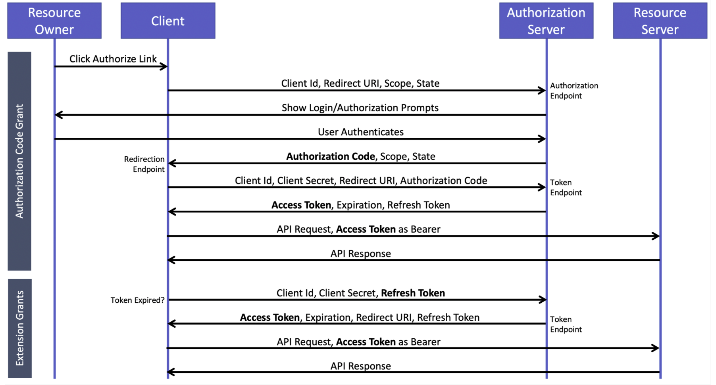
Simplified OAuth 2.0 auth_code flow
Notes:
Explain what could be go wrong!
CSRF with a different Redirect URI and improper validation could leak auth code (lack or weak validation for state parameter)
Improper Scope validation could lead to privilege escalation
If authorization code could potentially be replayed, it could lead issuing multiple access token
PKCE (Proof Key for Code Exchange) tries to protect from auth code injection attacks
How such attacks works (inject other auth code to a normal flow, in order to associate attackers session with a legitimate user’s one)
Countermeasure is pkce ( client creates code_verifier and hashes it - code challenge - then sends the hashed one into the initial request -its stored to the auth server - and in auth code’s redeeming sends code_verifier)
It ensures that the initiator is the same as the one that tries to redeem to access token.

Slide 14
Familiarizing with the attacks that we are dealing with
Stealing OAuth Token via redirect_uri
Improper handling of pkce parameter - authorization injection attacks
Reusability of an OAuth Token
Flawed scope validation
Improper handling of nonce parameter
Notes:
This attack works because of the improper validation or enlarged scope of accepted client’s redirect pages.
Use of * for example either on subdomains’ declaration or as path could be used to change the receiver of the OAuth Token.
It means that someone could be able to obtain OAuth Token and if also knows client’s credentials to redeem to an actual Access Token.
PKCE as mentioned earlier is the way to protect from CSRF attacks / also it’s done by state parameter. It was initially introduced to protect leaked or stolen authorization codes from being redeemed by malicious apps. (could this value be predictable ?)
If OAuth code is reusable someone could use it to issue more than one access tokens which is an issue.
If scope is not properly validated someone could obtain privileges that should not have.
Nonce: An attacker could attempt to replay valid requests in order to obtain or to modify/destroy user data.
The resource server could employ signed requests along with nonces and timestamps in order to uniquely identify requests. The resource server should detect and refuse every replayed request

Slide 15
03
METHODOLOGY

Slide 16
Methodology Analysis
(OBSERVATION & EXPERIMENT)
6 most popular OAuth Servers were under investigation:
default configuration and
How they implemented the RFCs in their solutions (e.g RFC 8414 - Authorization Server Metadata)
Because of interoperability issues which are very common issues in OAuth since it’s a prototype and it’s up to anyone to follow it accordingly we managed to automate the processes only for 3 of the servers (Keycloak, Casdoor, OKTA) which also are the most popular ones.
Notes:
OAuth Servers were under investigation:
Server Stars in Github
a12n-server 324
Casdoor 2.8k
Glewlwyd 377
Omejdn 4
Keycloak 12.2k
Also OKTA was the other OAuth Server since it’s the most popular solution and it’s not an open source but an enterprise one.

Slide 17
Methodology Analysis
Observation: The different implementations of the RFCs’ were collected and were tested to make patterns of them that were used in implementation. From what we managed to patternize we made the decision about the attacks that could potentially be easier to automate.
Experimental: We tried to perform the applied knowledge of the described attacks as they are mentioned in the RFC threat model document, tried to patternize and to automate some of the most important attacks.

Slide 18
Methodology Analysis
The attacks selected by the ease of their implementation and for the sake of experiment used demo environment of:
dummy malicious client application
and the system under test - several OAuth implementations.
Also the decision about the Authorization Code Flow came because it's the most common case of the flow especially on 3 tier web apps’ implementation.

Slide 19
04
IMPLEMENTATION

Slide 20
Implementation Details
OAuth Vulnerability scanner implemented in python language with a modular implementation to be easily extendable.
The project will be released in Github as open source an project to help the community to spot these vulnerabilities in several Authorization implementations.
Its implemented as CLI for the ease of usage.
Scanner also requires a .json configuration (settings.json) which is used to define target’s environment and some other characteristics of it.

Slide 21
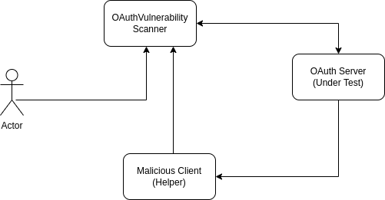
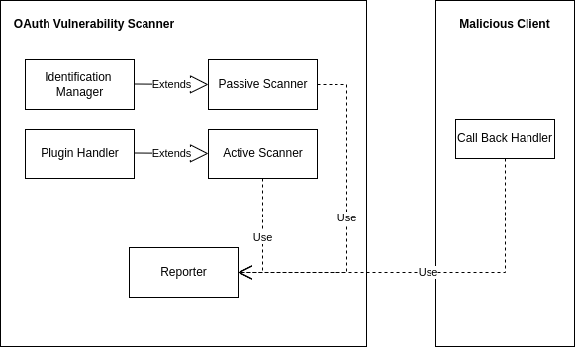
Implementation Design
High Level Architecture Entity Architecture Diagram

Slide 22
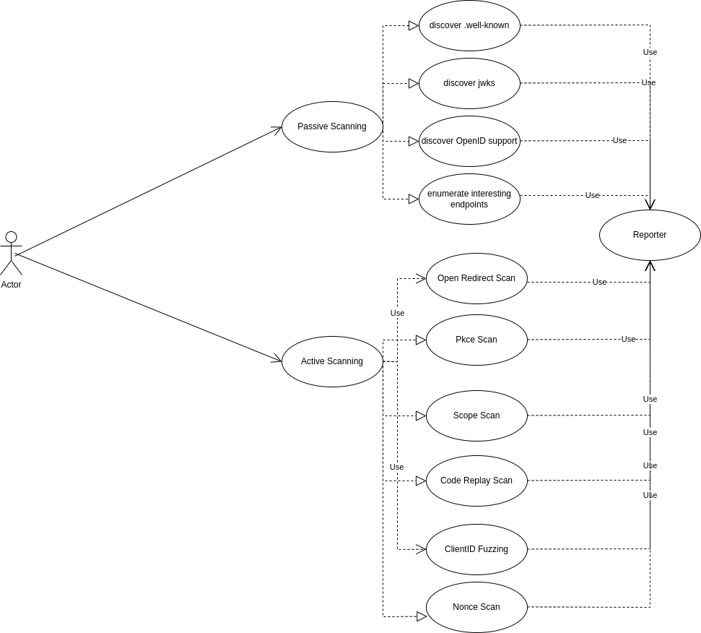
Use Cases Diagram

Slide 23
Explaining the diverse of functionalities
Tester is able to use passive scanning mode by using (-t p) option which applies a suite of predefined passive scanning tests.
Also by applying (-t a) the tester is able to active scan a target by selecting one or all of the aforementioned features.
It also has the capability to proceed with authentication related constraints by using a firefox based selenium agent (e.g SSO). The user is required to provide a proper authentication.
Other capabilities are the usage of log argument (to create debug logs) and proxy to integrate with several proxies (e.g Burp Suite)

Slide 24
05
RESULTS & FUTURE WORK

Slide 25
Results
Scanner tested 5 (open source) and 1 comercial server as targets:
Keycloak, Casdoor, A12, Omejdn, Glewlwyd, Okta
It managed to passive scan 5 of the above Authorization Servers and to scan actively Keycloak, Casdoor, Okta. It’s able to detect the aforementioned misconfigs in these 3 cases for Authorization Code Flow.
Notes:
OAuth Servers were under investigation:
Server Stars in Github
a12n-server 324
Casdoor 2.8k
Glewlwyd 377
Omejdn 4
Keycloak 12.2k
Also OKTA was the other OAuth Server since it’s the most popular solution and it’s not an open source but an enterprise one.

Slide 26
Future Work
Feature related updates:
  Scan for attacks in State Variable or other OAuth’s params.
  Expand attack surface in OpenID related attacks (this framework just enumerates and only checks for nonce)
  To extend with other plugins that scan for JWT vulnerabilities which potentially could be used as format of access token.
Support for other Authorization Flows
  Implicit (will deprecate in OAuth 2.1, but now is used)
  Client_credentials (M2M)
  Device (?)
Support of other Authorization Servers
  Potentially to handle cases of OAuth Servers that are not compatible with Authorization Server Metadata - RFC 8414
Notes:
Related Work:
Burp OAuth Scan
Requires Burp Pro (paid), it’s not a standalone tool, has differences in implemented features
KOAuth
Stability issues, not easy to configure, require a lot of user’s involvement. Lacks in features as passive scaning

Slide 27
Q&As

